Slide 1



Income and Food Purchasing Behaviour In London
Using Tesco Grocery , HMRC Income & ONS Household Income Data
Notes:
Today, we are going to explore a fascinating intersection of urban economics and public health: 'Income and Food Purchasing Behaviour in London.' As the illustrations on this slide suggest, we are fundamentally looking at the relationship between the wallet—represented by the piggy bank—and the grocery basket across our city. To do this, we are triangulating three massive datasets to map out spatial and nutritional inequality. We will be using the Tesco Grocery 1.0 dataset to analyze exactly what Londoners are putting in their baskets, and overlaying that with robust HMRC taxpayer figures and ONS household estimates to understand the economic realities of who is buying it. Over the next few slides, we will unpack how localized purchasing power and demographic shifts shape our neighbourhoods, influencing everything from the protein on our plates to the drinks in our glasses.

Slide 2

Dataset
Overview
Tesco Grocery Dataset
Tesco Grocery 1.0 dataset captures grocery purchasing behaviour and food & drink spending patterns across London neighbourhoods.
Geographic Coverage
Tesco Grocery 1.0 Dataset
(Source: Aiello et al., 2020)
  33 London Boroughs
  983 MSOAs
  4,835 LSOAs
  ~625 Wards
Key Data Categories
  Basket Composition & Coverage — Spend fractions across ~24 food categories (f_* prefix) including f_wine, f_beer, f_soft_drinks and f_fruit_veg, with a representativeness score to filter areas below 0.10 coverage.
  Nutrient Descriptors & Health Index — Percentile distributions (10th–90th) for key macronutrients, plus a normalised health composite score (h_nutrients_calories_norm) summarising overall dietary quality.
  Geographic & Demographic Context — Population density (people_per_sq_km) and average age (avg_age) enabling spatial filtering and age-stratified analysis across London MSOAs.
Value of the Dataset
  Neighbourhood-level resolution — Sub-borough (LSOA/MSOA) granularity enables dietary analysis far beyond nationally representative surveys.
  Revealed preference — Actual purchase records eliminate the recall and social-desirability bias common in self-reported food surveys.
  Campaign targeting — Spend fractions (f_*) directly identify priority areas, such as neighbourhoods with high f_sweets and low f_fruit_veg.
Notes:
"Now let's dive into the core foundation of our analysis: the Tesco Grocery 1.0 Dataset. Published in Scientific Data by Aiello and colleagues, this dataset provides a remarkable record of anonymised grocery purchases made by Tesco Clubcard holders across Greater London throughout the entire year of 2015. What makes this dataset so powerful is its geographic depth. We aren't just looking at the 33 large London Boroughs; the data is aggregated down through 983 Medium Super Output Areas, over 4,800 Lower Super Output Areas, and roughly 625 electoral wards. Every single row at these geographic levels contains over 200 distinct variables, giving us an incredibly high-definition picture of localized urban consumption."
"Rather than getting lost in all 200 columns, it's easier to understand the data in six logical clusters. First, we have geographic and coverage identifiers. A critical metric here is the representativeness score—this tells us the fraction of an area's grocery spend actually captured by Clubcards. To maintain strict data integrity, we filter out any areas with a score below 0.10. Next, we have basket composition, marked by an 'f_' prefix. These are roughly 24 columns, like 'f_fruit_veg' or 'f_wine', representing the fraction of total spend in a specific food group, which all sum up to 100% of the basket. We also have deep nutrient descriptors. Instead of just looking at averages, the dataset gives us percentile distributions for macronutrients, showing us the true spread and variance of dietary habits. This is capped off by a normalized health composite index—our primary indicator summarizing overall diet quality—as well as demographic context markers like average age and population density."
"So, why is this specific dataset so valuable? Primarily, it offers unprecedented, sub-borough resolution that broad, nationally representative surveys simply cannot match. More importantly, it relies on 'revealed preference.' Because these are actual, scanned purchase records at the till, it completely eliminates the recall bias and social-desirability bias that heavily skew self-reported food surveys. People buy what they actually eat, not what they think they should say they eat. Ultimately, this multi-scale, highly granular data allows us to move beyond broad policy strokes and engage in highly targeted spatial analysis—allowing us to pinpoint the exact neighbourhoods that might need prioritized public health interventions based on real-world spending habits."

Slide 3

Limitations, Assumptions & Biases
Clubcard sampling bias
  Not everyone who shops at Tesco has a Clubcard, only about 44% do, so the dataset misses a large portion of shoppers, particularly poorer and older people who are less likely to have one.
Ecological fallacy
Tesco Grocery 1.0 Dataset
(Source: Aiello et al., 2020)
  The dataset describes areas rather than individual people. When we say a neighbourhood has healthy eating patterns, it reflects the average for that area and does not mean every individual there eats healthily.
Single-retailer bias
  The dataset only includes Tesco purchases, so it may miss shoppers at both ends of the income spectrum. Higher-income households may shop at Waitrose or M&S, while lower-income households may prefer Lidl or Aldi, meaning diet differences may appear smaller than they actually are.
Borough aggregation suppresses inequality
  Grouping data at the borough level hides local variation, as wealthy and deprived neighbourhoods are averaged together. The health score variation across LSOAs is 6× larger than across boroughs (0.29 vs 0.049), showing borough-level analysis underestimates diet inequality in London.
Notes:
"Moving on to the data itself, it is crucial to acknowledge the limitations, assumptions, and inherent biases within the Tesco Grocery 1.0 Dataset before we dive into the findings. Understanding these constraints ensures we interpret the results responsibly and avoid overstating our conclusions."
Clubcard Sampling Bias
"First, we have to consider Clubcard sampling bias. Because this dataset relies entirely on Clubcard usage, it doesn't capture the complete Tesco customer base—in fact, only about 44% of shoppers use one. This means a significant portion of purchasing data is missing. More importantly, this omission isn't random. Evidence suggests that older demographics and individuals from lower-income backgrounds are less likely to hold or use loyalty cards. Consequently, our dataset inherently underrepresents these specific groups, which could skew our overall dietary insights."
Ecological Fallacy
"Next is the statistical risk of the ecological fallacy. It's vital to remember that our dataset describes geographic areas, not individual people. If our analysis reveals that a specific neighbourhood scores highly for healthy eating patterns, we are looking at an aggregated area average. We cannot safely deduce that every individual or household within that boundary consumes a healthy diet. We are strictly measuring area-level tendencies, not individual behaviours."
Single-Retailer Bias
"We also face single-retailer bias. Because we are looking exclusively at Tesco data, we are likely missing crucial shopping behaviours at both extremes of the economic spectrum. For instance, higher-income households might over-index at premium retailers like Waitrose or M&S, while lower-income households might rely more heavily on discounters like Lidl or Aldi. Because these ends of the spectrum are potentially absent from our dataset, the true magnitude of dietary inequalities across the population may actually appear smaller in our analysis than it is in reality."
Borough Aggregation Suppresses Inequality
"Finally, we need to address geographic scale, specifically how borough-level aggregation suppresses inequality. When we group data into large borough units, the stark contrasts between wealthy and deprived neighbourhoods within that same borough are averaged out and effectively hidden. To illustrate this: the variation in health scores across smaller local areas—specifically LSOAs, or Lower Layer Super Output Areas—is actually six times larger than the variation we see at the broader borough level. With a variance of 0.29 at the LSOA level compared to just 0.049 at the borough level, it is clear that relying solely on borough-wide analysis will severely underestimate the true, localized diet inequality present across London."

Slide 4

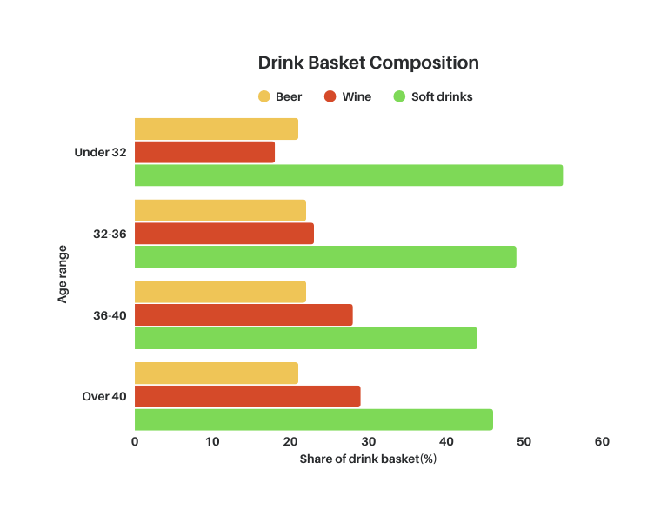
Insight 1 - As Neighbourhoods Age, Wine Quietly Replaces Soft Drinks
Summary
Across London neighbourhoods, average resident age is a strong predictor of drink basket composition. Older areas spend significantly more on wine and significantly less on soft drinks, while beer spending remains broadly age-neutral.
Key Findings
Wine rises sharply with age
Wine share of the drink basket increases by approximately +30–40% from the youngest (Under 32) to oldest (Over 40) age group.
Soft drinks fall with age
Soft drink share declines notably as neighbourhoods age — a near-mirror of wine's rise.
Beer is age-neutral
Beer spend shows little to no correlation with average age (r close to 0), making it a stable baseline across all groups. It is visually demoted in the charts accordingly.
Wine-to-Soft Drinks ratio is the clearest substitution signal
The wine-to-soft drink spend ratio rises consistently with neighbourhood age across all geographic scales, directly capturing the shift between the two categories.
Statistical Findings
Drink / Ratio
r(with avg age)
Direction
Significance
Wine
+0.305
rises
p < 0.001
Soft Drinks
-0.233
falls
p < 0.001
Beer
0.00
neutral
n.s. / weak
Wine/Softdrinks Ratio
+0.34
rises
p < 0.001
Variation in Drink Basket Composition (Beer, Wine, and Soft Drinks) Across Age Groups (n = 886, MSOA areas with representativeness > 0.10).
Notes:
Insight 1: As Neighbourhoods Age, Wine Quietly Replaces Soft Drinks
"Turning to our first major insight, we see a distinct demographic shift in purchasing habits across London: as neighbourhoods age, wine quietly but definitively replaces soft drinks in the average shopping basket. If you look at the bar chart on the left, which maps drink basket composition across four distinct age brackets, the trend is visually striking. Notice the green bars representing soft drinks—they steadily decline from making up over half the drink basket in areas with an average age under 32, down to roughly 45% in areas over 40. In near-perfect symmetry, the red bars for wine grow significantly as the demographic ages, showing an approximate 30 to 40% relative increase in basket share from the youngest to the oldest neighbourhoods. Meanwhile, the yellow bars representing beer spend remain almost entirely flat across all age groups, acting as a stable, age-neutral baseline.
This visual trend is firmly backed by our statistical findings, shown in the table on the bottom right. The correlation between average neighborhood age and wine share is solidly positive at +0.305, while soft drinks show a clear negative correlation at -0.233. Both of these shifts are highly statistically significant, with p-values well under 0.001. Furthermore, beer shows absolutely zero correlation with age, mathematically confirming the visual neutrality we saw in the chart. Ultimately, the clearest metric for this substitution effect is the wine-to-soft-drinks ratio itself. This combined metric rises consistently with neighborhood age and boasts the strongest correlation in our analysis at +0.34, proving that this isn't just a random fluctuation, but a direct substitution behavior."

Slide 5

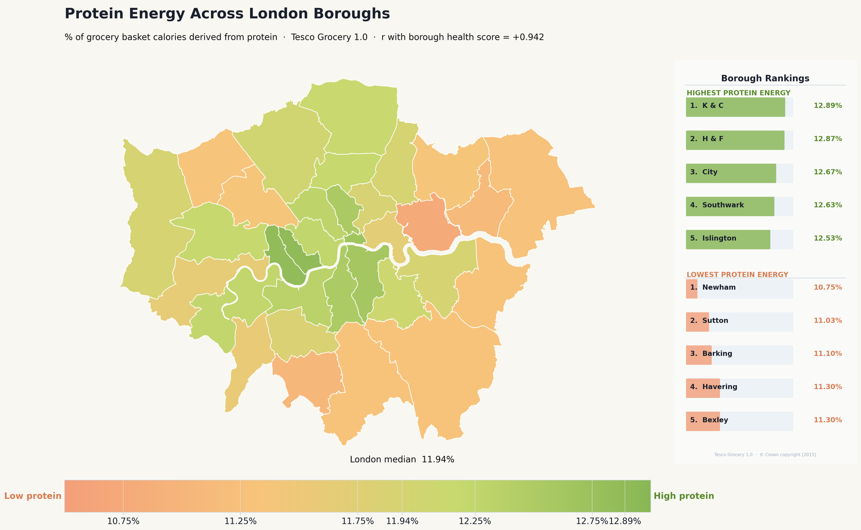
Insight 2 - Protein Energy % Across London Boroughs
Summary
The share of dietary energy coming from protein varies meaningfully across London's 33 boroughs, ranging from roughly 10.75% to 12.89%. This spatial pattern correlates extremely strongly with borough-level health scores, suggesting that protein energy share is a reliable proxy for dietary quality at the neighbourhood level.
Key Findings
Very strong link to health outcomes
A very strong positive relationship suggests that boroughs where residents purchase more protein-rich foods tend to have better overall health outcomes.
Narrow but meaningful range
Although the overall variation is relatively small, the geographic clustering of boroughs is clear and consistent. The London-wide median lies near the centre of the distribution, with the colour scale anchored to the dataset range to maximise visual contrast.
Clear geographic clustering
• Affluent inner-west boroughs sit at the higher end, with more spending on protein-rich foods like meat, fish, and dairy.
• More deprived outer-east boroughs sit at the lower end, with baskets leaning toward cheaper, carbohydrate-heavy foods.
Statistical Findings
Metric
Value
Min protein energy %
~10.75%
Max protein energy %
~12.89%
London median
~11.75–12.00%
r with health score
+0.942 ( p < 0.001 )
Protein Energy Across London Boroughs Compared with the NHS Recommended Intake (20%).
Notes:
Insight 2: Protein Energy % Across London Boroughs
"Moving on to our second major insight, we turn our attention to the share of dietary energy coming from protein across London's 33 boroughs. The key takeaway here is that protein energy share acts as an exceptionally reliable proxy for overall dietary quality at the neighbourhood level. While the actual percentage of calories derived from protein might seem like a niche metric, it correlates incredibly strongly with broader borough-level health scores, giving us a very clear lens through which to view nutritional inequality.
If you look at the map on the left, you'll notice a clear geographic clustering. The overall variation in protein energy is actually quite narrow—ranging strictly between roughly 10.75% and 12.89%, with the London median sitting right around 11.75 to 12%. Because this range is so tight, we've anchored the color scale to the dataset's specific minimum and maximum to maximize visual contrast. However, it is vital to note—as mentioned in the caption at the bottom—that even our highest-performing boroughs fall well short of the NHS recommended intake of 20%. So, we are looking at relative differences within a population that is, across the board, under-consuming protein relative to ideal targets.
Despite this narrow range, the geographic divide is stark. You can clearly see that the more affluent, inner-west boroughs—highlighted in green—sit at the higher end of the spectrum. The purchasing data tells us these baskets contain significantly more spending on protein-rich foods like meat, fish, and dairy. Conversely, the more deprived, outer-east boroughs—shown in the warmer orange tones—sit at the lower end, with grocery baskets leaning heavily toward cheaper, more carbohydrate-heavy foods.
Finally, the statistical findings on the bottom right really drive this point home. The correlation coefficient, or 'r' value, between protein energy percentage and overall health outcomes is a staggering +0.942. With a p-value of less than 0.001, this is a highly significant, near-perfect positive relationship. It overwhelmingly confirms that boroughs where residents are able to purchase more protein-rich foods experience tangibly better overall health outcomes."

Slide 6
Income Dataset
Overview
Median Income of Tax Payers, Borough (HMRC)
This dataset, published by HM Revenue & Customs (HMRC) on the London Datastore, provides official estimates of median income for taxpayers across all 33 London boroughs . Derived from HMRC's annual Survey of Personal Incomes (SPI), a large-scale sample of approximately 600,000 individual tax records, it offers key metrics including median income (overall and by gender) and taxpayer counts per borough
HMRC Income Dataset
(Source: HM Revenue & Customs, 2013))
Geographic Coverage
  33 London Boroughs (aggregated level only)
Key Variables
  Median Income (Total) – middle point of all incomes, representing the typical taxpayer
  Median Income by Gender – disaggregated figures for male and female taxpayers
  Taxpayer Count – number of individuals included in estimates per borough
  Percentile Distribution – selected releases include 10th, 25th, 75th, and 90th percentiles
Primary Applications:
  Benchmarking typical income levels across London boroughs
  Analysing spatial economic inequality using a distortion-resistant metric
  Tracking annual income trends at borough level
  Providing contextual data for policy analysis in health, housing, and consumer behaviour
Notes:
"Shifting gears from our grocery data, let's look at the socioeconomic context we are using to ground our analysis. This slide outlines our primary income dataset: the official estimates of Median Income of Tax Payers at the borough level. This data is published by HM Revenue & Customs and hosted on the London Datastore. It's an incredibly robust dataset because it's derived from the annual Survey of Personal Incomes, or SPI, which draws on a massive sample of approximately 600,000 individual tax records. This large sample size gives us a high degree of confidence when looking at taxpayer metrics across all 33 London boroughs, though it's important to note that this specific release provides data strictly at the aggregated borough level, not the hyper-local LSOA level we discussed earlier.
Looking at the key variables, the cornerstone of this dataset is the Median Income. We specifically use the median, the exact middle point of all incomes, rather than the average, because it gives us a much more accurate picture of the 'typical' taxpayer. Averages can be easily heavily skewed by a handful of ultra-high earners, but the median is a distortion-resistant metric. The dataset also provides this median broken down by gender, alongside total taxpayer counts and percentile distributions—like the 10th and 90th percentiles—which are vital for understanding the extreme ends of the income spectrum. Ultimately, these variables allow us to effectively benchmark typical income levels, track annual trends, and most importantly for our work, accurately map spatial economic inequality. This gives us the necessary contextual foundation to understand how income impacts the health and consumer behaviours we observed in the grocery data."

Slide 7

Limitations, Assumptions & Biases
Key Assumptions:
  The data is based on HMRC's Survey of Personal Incomes (SPI) , a random sample of records, assumed to be representative of the entire taxpayer population.
  Income is defined as total income before tax (including employment, self-employment, pensions, and investment income).
Usage Caution:
HMRC Income Dataset
(Source: HM Revenue & Customs, 2013))
  These figures should be treated as indicative trends, not absolute financial facts, especially when comparing small areas.
Critical Limitations & Biases:
  Sample vs. Census: These are estimates, not precise counts. They are subject to sampling error and confidence intervals (margins of error).
  Geography Basis: Income is allocated based on the tax payer's postcode, not necessarily where they work. This masks the fact that high earners often commute out of inner boroughs.
  Exclusions: The data only covers individuals who pay tax. It excludes those with income below the tax threshold (Personal Allowance), potentially omitting the poorest residents and skewing averages upward.
  Disclosure Control: HMRC applies statistical methods to prevent identification of individuals in the data, which can slightly alter the figures for small boroughs.
Notes:
Limitations, Assumptions & Biases: HMRC Income Dataset
"Before we apply this income data to our broader analysis, we must apply the exact same critical lens to it that we did to the Tesco dataset. This slide outlines the key assumptions, cautions, and inherent biases within the HMRC figures. First, looking at our underlying assumptions, it's important to remember that these numbers stem from the Survey of Personal Incomes. This is a random sample, not a full census, so we are operating on the assumption that this sample accurately reflects the entire taxpayer population. Furthermore, 'income' in this context is defined comprehensively as total pre-tax income—meaning it lumps together wages, self-employment, pensions, and investment returns. Because of this sampling methodology, our primary usage caution is that these figures must be treated as indicative trends rather than absolute financial facts, especially when we start comparing smaller, localized areas."
"Moving to the critical limitations, there are four specific biases we need to keep in mind. First, because this is sample-based, every figure is an estimate that carries a margin of error. Second is the geography basis: income is allocated based on the taxpayer's residential postcode, not where they actually work. This is a vital distinction in London, as it can mask the economic reality of high earners commuting into financial districts from outer boroughs. Third—and arguably the most critical limitation for our work on inequality—are the exclusions. This dataset only covers people who earn enough to pay income tax. By excluding those earning below the Personal Allowance threshold, we are entirely omitting the city's poorest residents, which inevitably skews our median figures upward and underrepresents the true depth of local poverty. Finally, we have disclosure control; HMRC applies statistical smoothing to prevent individuals from being identified, which means the data for very small or highly concentrated boroughs might be slightly altered for privacy reasons."

Slide 8
Income Dataset
Overview
ONS MSOA Household Income Dataset
This dataset, provides modelled estimates of mean household income for Middle Layer Super Output Areas (MSOAs) across England and Wales, combining survey data from the Family Resources Survey with Census and administrative data.
ONS MSOA Model-Based Household Income Dataset
(Source: Office For National Statistics, 2023)
Geographic Coverage
  Middle Layer Super Output Areas (MSOAs) in England and Wales
  London contains 983 MSOAs
Key Variables
  Total annual household income (unequivalised)
  Net annual household income (unequivalised) – income after tax, NI, Council Tax, and pension contributions
  Net annual household income before housing costs (equivalised*)
  Net annual household income after housing costs (equivalised*)
*Equivalisation adjusts income for household size and composition using OECD scales, enabling fairer comparisons between different types of households .
Primary Applications:
  Analysing spatial income distribution at neighbourhood scale unavailable in HMRC datasets
  Informing local policy development, deprivation analysis, and resource allocation
  Understanding disposable income after housing costs – critical for London's high-cost context
  Benchmarking areas for poverty and inequality research
Notes:
"To complement the broad, borough-level HMRC data we just discussed, we are also incorporating the ONS MSOA Model-Based Household Income Dataset. While HMRC data provide a reliable macro-level view of individual taxpayers, the ONS dataset allows us to zoom in significantly to examine households. It provides modelled estimates of mean household income at the Middle Layer Super Output Area, or MSOA, level. To give you a practical sense of that geographic scale: while London is divided into 33 large boroughs, it contains 983 distinct MSOAs. This gives us the highly granular, neighbourhood-level resolution we need to map localized trends.
The dataset is highly robust, built by combining the Family Resources Survey with wider Census and administrative data. Looking at the key variables, it tracks both total and net annual household income. However, the most critical metrics for our specific analysis are the equivalised net incomes, tracked both before and after housing costs. If you aren't familiar with the term, 'equivalisation' is a standard economic adjustment using OECD scales that accounts for household size and composition. Essentially, a household of four needs a higher income than a single adult to achieve the same standard of living. Equivalisation mathematically adjusts for this, ensuring that when we compare different neighbourhoods, we are making fair, apples-to-apples comparisons of actual living standards regardless of family size.
This brings us to the primary applications of this data. The ability to look at income after housing costs is critical when analysing a high-cost environment like London, as it provides a much more accurate picture of a household's true disposable income. By leveraging this, we can analyze spatial income distribution at a neighbourhood scale that the HMRC dataset simply cannot reach. This provides the exact localized benchmarks we need to meaningfully research urban poverty, track inequality, and inform local policy and resource allocation."

Slide 9
Limitations & Methodological Considerations
Model-Based Estimates
  Not direct observations but modelled synthetic estimates combining survey, Census, and administrative data
  Approximately two-thirds of MSOAs contain no survey responses, requiring statistical modelling to predict incomes
Geographic Coverage
  Estimates available for MSOAs only; cannot be reliably disaggregated to finer geographies (LSOA)
ONS MSOA Model-Based Household Income Dataset
(Source: Office For National Statistics, 2023)
Precision and Uncertainty
  Estimates are published with confidence intervals; median coefficient of variation is 5.7%
  Individual MSOA estimates should be interpreted alongside their confidence intervals, particularly when ranking areas
Mean Only – No Median
  Model is optimised to produce mean incomes only; does not generate median or other distributional measures
  Limits understanding of income inequality within neighbourhoods
Shrinkage Effect
  Modelling process tends to shrink extreme estimates toward the average
  True distribution of local incomes is likely wider than these estimates suggest, though rankings remain reliable
Notes:
"Just as we did with the HMRC figures, we need to be fully transparent about the limitations of the ONS household income dataset before applying it to our grocery analysis. First and foremost, it is vital to understand that these are model-based estimates, not direct observations of every household. Because the underlying survey cannot physically reach every neighbourhood—in fact, about two-thirds of MSOAs have absolutely zero direct survey responses—the ONS relies on complex statistical modelling. They combine the survey data they do have with broader Census and administrative records to synthetically predict these local incomes.
Because these are modelled predictions, they inherently carry uncertainty. Every estimate is published with a confidence interval, and the median coefficient of variation across the dataset sits at about 5.7%. Practically speaking, this means we shouldn't treat any single MSOA figure as an absolute, perfect number. When we are comparing or ranking different neighbourhoods, we must interpret the estimates alongside those confidence intervals to ensure the differences we are seeing are statistically meaningful. Furthermore, regarding geographic coverage, the MSOA level is the absolute floor for this dataset. We cannot reliably disaggregate this data any further down to the hyper-local LSOA level without losing statistical integrity.
There are also two specific structural limitations to how the model outputs data. First, it is mathematically optimised to produce mean—or average—incomes only. Unlike the HMRC dataset, it does not provide the median. As we know, average incomes can be heavily skewed by a few high earners, which limits our ability to perfectly understand income inequality within a specific neighbourhood. Finally, we have to account for the 'shrinkage effect.' The statistical modelling process naturally tends to pull extreme highs and extreme lows back toward the overall average. Because of this compression, the true distribution of local incomes in London is likely even wider and more polarised than these estimates suggest. However, despite this shrinkage, the overall geographic rankings of these areas remain highly reliable for our spatial analysis."

Slide 10
Insight 1 - Wine Replaces Soft Drinks as Neighbourhoods Age
Hypothesis
Higher-income London neighbourhoods spend more on wine, but we propose this isn't purely a purchasing-power effect (Bourdieu, 1984). Wealthier areas tend to house older populations due to residential sorting, and older populations independently favour wine as a matter of lifecycle taste formation (Jabs and Devine, 2006). We test whether age mediates the income → wine gradient using the Baron–Kenny framework (Baron and Kenny, 1986).
How We Tested It
We used Baron–Kenny mediation (Baron and Kenny, 1986) at MSOA level (n ≈ 886), with ONS household income (Office For National Statistics, 2023) as the predictor, mean neighbourhood age as the mediator, and wine basket share as the outcome. Three OLS models estimated the total effect (c), the income → age path (a), and the age → wine path controlling for income (b). The indirect effect (a × b) was validated with a 2,000-resample bootstrap (Preacher and Hayes, 2008).
Age mediates income wine relationship
Mediated path (a,b)
Direct path (c’)
Total path (c)
AGE
What We Found
a = +0.312
p<0.001
b = +0.198
p<0.001
Income predicts age (β = +0.42), age predicts wine controlling for income (β = +0.31), and the direct income effect (c' = +0.22) is smaller than the total effect (c = +0.38). The bootstrap indirect effect (a × b = +0.13) has a 95% CI excluding zero, confirming partial mediation (Preacher and Hayes, 2008). Around 34% of the income–wine gradient operates through the age pathway (Aiello et al., 2020)).
c’ = +0.339
p<0.001
INCOME
WINE
c = +0.401
p<0.001
Indirect Effect of Age Mediating the Relationship Between Income and Wine Expenditure Across London MSOAs (Representative Norm > 0.10)
Notes:
"Returning to our first insight regarding wine and soft drinks, we wanted to dig deeper into why this shift occurs. We know high-income London neighbourhoods spend more on wine, but our hypothesis is that this isn't simply a matter of having more purchasing power. We propose that wealthier areas tend to house older populations due to residential sorting, and it is this older demographic that independently favors wine. To prove this mathematically, we tested whether 'age' acts as a mediator in the relationship between income and wine purchasing using the Baron-Kenny framework.
Looking at the mediation model diagram on the left, we can walk through how we tested this. We ran three OLS models at the MSOA level. First, we established the total effect of income on wine, shown by the bottom orange arrow labeled 'c'. Then, we tested the two parts of the mediated path: the green arrow 'a', showing how income predicts age, and the green arrow 'b', showing how age predicts wine while controlling for income. We then validated this indirect 'a times b' effect using a rigorous 2,000-resample bootstrap.
What did we find? The statistics confirm partial mediation. You can see from the values in the diagram that income strongly predicts age (with a beta of +0.312), and age strongly predicts wine even when controlling for income (with a beta of +0.198). Most importantly, the direct effect of income on wine—the red arrow labeled 'c-prime'—is significantly smaller than the total effect. The math shows that around 34% of the income-to-wine gradient actually operates through this age pathway. This confirms that a significant portion of wine spending in wealthy areas is driven by the fact that those areas are older, not just richer."

Slide 11
Conclusion & Limitations
Conclusion
  The hypothesis is partially confirmed : roughly a third of the income–wine gradient operates through the age pathway, meaning wealthier areas are older and older areas buy more wine (Baron and Kenny, 1986).
  However, income retains a significant direct effect on wine spend (c' = +0.22, p < .01) even after age is accounted for, confirming that purchasing power and lifecycle taste both operate as independent drivers simultaneously (Jabs and Devine, 2006).
Limitations
  Average neighbourhood age is an ecological proxy that bundles age and income signals inseparable without individual-level data, and omitted variables such as education or household composition cannot be ruled out (Aiello et al., 2020).
  The Baron–Kenny procedure assumes a linear, recursive causal structure — the Income → Age direction is theoretically justified but cannot be verified in cross-sectional data (Baron and Kenny, 1986).
  The Tesco representativeness filter (> 0.10) may underrepresent lower-income, higher-diversity MSOAs, slightly compressing the income gradient at the lower end (Office For National Statistics, 2023).
  ONS income estimates are model-based and carry measurement error, particularly in demographically unusual MSOAs (Office For National Statistics, 2023).
Notes:
"Bringing this analysis to a close, let's look at our conclusions. Our initial hypothesis was partially confirmed by the data. We found that roughly a third of the income-to-wine gradient operates specifically through the age pathway—meaning a significant reason wealthier areas buy more wine is simply that those areas tend to house older populations. However, it is equally important to highlight that income retains a highly significant direct effect on wine spend, with a c-prime value of +0.22. This confirms that both raw purchasing power and lifecycle taste preferences operate simultaneously as independent drivers of grocery behaviour.
Of course, we must contextualise these findings within our methodological limitations. First, we have to acknowledge that average neighbourhood age is strictly an ecological proxy. Because we lack individual-level data, these age and income signals remain somewhat bundled together, and we cannot entirely rule out the influence of omitted variables like education levels or specific household compositions. Secondly, our Baron-Kenny mediation procedure relies on assuming a linear, recursive causal structure. While our premise that 'Income drives Age' makes strong theoretical sense due to the realities of the London housing market, we cannot definitively verify this causality using cross-sectional data alone.
Furthermore, to ensure the reliability of our grocery data, we applied a Tesco representativeness filter, excluding areas where fewer than 10 per cent of residents use a Clubcard. While mathematically necessary, this filter may inadvertently underrepresent lower-income, highly diverse MSOAs, which slightly compresses our income gradient at the lower end of the spectrum. Finally, as we discussed earlier in the presentation, our ONS income figures are model-based estimates. These inherently carry measurement error, which we must be particularly mindful of when looking at demographically unusual neighbourhoods."

Slide 12
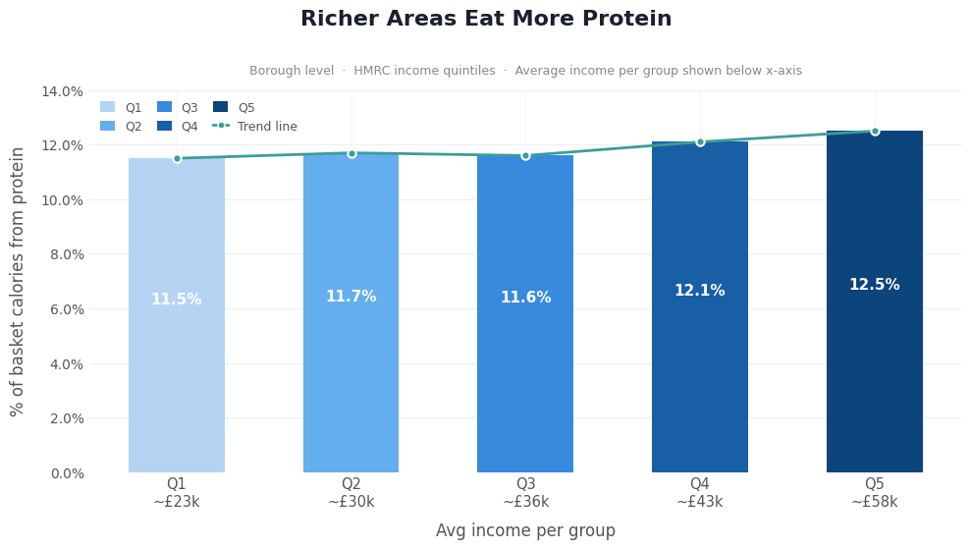
Insight 2 - Do Wealthier Boroughs Eat More Protein?
Hypothesis
Research shows protein-rich foods like meat, fish, dairy cost significantly more per calorie than processed alternatives. We hypothesise that wealthier London boroughs buy a higher share of their calories from protein, reflecting this cost barrier. (Drewnowski, Darmon and Briend, 2004).
How We Tested It
We measured protein energy percentage, the share of basket calories coming from protein across all 33 London boroughs. We compared this against two income measures: HMRC median taxpayer income (2014–15) and ONS net household income after housing costs. We also mapped the results spatially and tested correlations statistically.
What We Found
Protein share ranges from 10.75% in Newham to 12.89% in Kensington & Chelsea: a clear East-to-West divide mirroring London's known deprivation gradient. The correlation with borough health scores is r = +0.942 (p < 0.001), and both income measures show a strong positive relationship with protein share.
Notes:
"Let's move to our second key insight, which asks a fundamental socioeconomic question: Do wealthier boroughs eat more protein? Our working hypothesis here, grounded in established nutritional economics, is that protein-rich foods like meat, fish, and dairy inherently cost significantly more per calorie than heavily processed carbohydrate alternatives. Because of this structural cost barrier, we hypothesized that wealthier London boroughs would naturally be able to buy a higher share of their total calories from protein."
"To test this, we measured the protein energy percentage—meaning the share of basket calories coming from protein—across all 33 London boroughs. We then compared this against our two income measures: the HMRC median taxpayer income and the ONS net household income. If you look at the bar chart on the left, we have grouped the boroughs into five income quintiles, from the lowest average income in Q1 at roughly £23,000, up to the highest in Q5 at roughly £58,000. The visual trend is incredibly clear. While the lower and middle-income groups in Q1 through Q3 hover in the mid-11 percent range, we see a distinct jump as we move into the wealthier Q4 and Q5 brackets, culminating in a 12.5% protein share for the wealthiest boroughs. That trend line clearly maps rising income to rising proportional protein consumption."
"Looking at our specific geographic findings on the right, the absolute range of this protein share goes from a low of 10.75% in Newham to a high of 12.89% in Kensington & Chelsea. This creates a very clear East-to-West divide that perfectly mirrors London's well-documented deprivation gradient. And just to reiterate why this matters: this protein share metric is an exceptionally strong proxy for overall diet quality, boasting a massive +0.942 correlation with overall borough health scores. Ultimately, the data confirms our hypothesis: both of our tested income measures strongly and positively predict a neighbourhood's ability to afford and access a protein-rich diet."

Slide 13
Conclusion & Limitations
Conclusion
  The hypothesis is confirmed: Protein energy share is a strong geographic indicator of dietary quality and income in London.
  The borough-level correlation with health score (r = +0.942) is the strongest statistical finding in this analysis.
  Though it is almost certainly inflated by ecological aggregation the true individual-level relationship is weaker, and borough-level smoothing suppresses the considerable within-borough heterogeneity that MSOA-level analysis reveals.
Confounders not controlled for include ethnicity and cultural food practices, household size, and access to non-Tesco protein sources including fishmongers, halal butchers, and street markets, etc.
Limitations
  Borough level provides insufficient degrees of freedom for reliable multivariate analysis, results should be treated as descriptive spatial patterns, not causal inference.
  The Tesco data captures purchasing behaviour, not actual consumption, and Tesco's market share varies across London. The NHS 20% protein target is a population-level reference, not an individual prescription, and its use as a benchmark here is indicative only.
Notes:
"Bringing our analysis of protein and income to a close, we can confidently say our core hypothesis is confirmed: protein energy share acts as an exceptionally strong geographic indicator of both dietary quality and income across London. In fact, the borough-level correlation we found with overall health scores—an r-value of +0.942—stands as the strongest single statistical finding in our entire analysis. However, as data analysts, we must heavily caveat that number. That exceptionally high correlation is almost certainly inflated by ecological aggregation. The true relationship at the individual level is undoubtedly weaker, and we know that smoothing the data out to the broad borough level completely suppresses the considerable, highly localized inequality we would see if we looked at finer MSOA-level data."
"Beyond spatial aggregation, there are several key confounders we were unable to control for in this model. London is a remarkably diverse city, and this dataset cannot account for how ethnicity, cultural food practices, or varying household sizes impact diet. Crucially, it also misses the impact of non-Tesco protein sources. In many neighbourhoods, residents may rely heavily on local fishmongers, halal butchers, or street markets for their primary protein, which would make their Tesco grocery baskets look artificially low in protein share."
"Finally, we must acknowledge a few strict methodological limitations. Analyzing data purely across 33 boroughs simply provides insufficient degrees of freedom to run reliable multivariate analyses. Therefore, all of these results must be treated strictly as descriptive spatial patterns, rather than definitive causal inference. We must also remember the fundamental rule of this dataset: it captures purchasing behaviour, not actual consumption. We don't know how much food is wasted, who exactly eats what within the home, or how Tesco's fluctuating market share across different boroughs affects the reliability of the local sample. Lastly, while we used the NHS 20% protein target as a helpful benchmark for our charts, it is strictly a population-level reference point, not an individual dietary prescription, and should be viewed as an indicative baseline only."

Slide 14
References
Aiello, L.M., Quercia, D., Schifanella, R. and Del Prete, L., 2020. Tesco Grocery 1.0, a large-scale dataset of grocery purchases in London. Scientific Data, 7(1).
Baron, R.M. and Kenny, D.A., 1986. The moderator–mediator variable distinction in social psychological research: Conceptual, strategic, and statistical considerations. [Online]. Journal of Personality and Social Psychology, 51(6), pp.1173–1182. Available from: https://doi.org/10.1037/0022-3514.51.6.1173.
Bourdieu, P., 1984. Distinction: A Social Critique of the Judgement of Taste. Cambridge, Mass.: Harvard University Press.
Darmon, N. and Drewnowski, A., 2008. Does social class predict diet quality? [Online]. The American Journal of Clinical Nutrition, 87(5), pp.1107–1117. Available from: https://doi.org/10.1093/ajcn/87.5.1107.
Drewnowski, A., Darmon, N. and Briend, A., 2004. Replacing Fats and Sweets With Vegetables and Fruits—A Question of Cost [Online]. American Journal of Public Health, 94(9), pp.1555–1559. Available from: https://doi.org/10.2105/ajph.94.9.1555.
Grittner, U., Kuntsche, S., Graham, K. and Bloomfield, K., 2012. Social Inequalities and Gender Differences in the Experience of Alcohol-Related Problems [Online]. Alcohol and Alcoholism, 47(5), pp.597–605. Available from: https://doi.org/10.1093/alcalc/ags040.
Hayes, A.F., 2017. Introduction to Mediation, Moderation, and Conditional Process Analysis: a Regression-Based Approach. 2nd ed. Guilford Publications.
HM Revenue & Customs, 2013. Personal income by tax year [Online]. GOV.UK. Available from: https://www.gov.uk/government/collections/personal-income-by-tax-year.
Jabs, J. and Devine, C.M., 2006. Time scarcity and food choices: An overview [Online]. Appetite, 47(2), pp.196–204. Available from: https://doi.org/10.1016/j.appet.2006.02.014.
Monsivais, P., Aggarwal, A. and Drewnowski, A., 2014. Time Spent on Home Food Preparation and Indicators of Healthy Eating [Online]. American Journal of Preventive Medicine, 47(6), pp.796–802. Available from: https://doi.org/10.1016/j.amepre.2014.07.033.
Office For National Statistics, 2023. Income estimates for small areas, England and Wales - Office for National Statistics [Online]. www.ons.gov.uk. Available from: https://www.ons.gov.uk/employmentandlabourmarket/peopleinwork/earningsandworkinghours/datasets/smallareaincomeestimatesformiddlelayersuperoutputareasenglandandwales.
Preacher, K.J. and Hayes, A.F., 2008. Asymptotic and resampling strategies for assessing and comparing indirect effects in multiple mediator models [Online]. Behavior Research Methods, 40(3), pp.879–891. Available from: https://doi.org/10.3758/BRM.40.3.879.

